Slide 1

WELCOME TO OUR 2019
ANNUAL GENERAL MEETING (AGM)
Email: info@hernebay1011.nz

Slide 2
Your Committee
Co – Chairs – Dirk Hudig, Don Mathieson
Marian Kohler – Heritage and Street Trees, Door
Alastair McLaren – Chair Traffic sub committee
Peter Stewart – Communications and traffic sub committee
John Fay – Traffic sub committee
Gray Sorrell - Traffic sub committee
Kate Stanton – Committee and Door
Neil Spencer – Committee

Slide 3
Secretary Wanted
Agenda preparation, minute taking, website updating, PowerPoint preparation and membership list maintenance.
Weekly the input would be light but there are busy periods (e.g. around AGM). Computer skills would be helpful.
Contact a committee member or email.

Slide 4
Traffic and Roading
Northern Slopes Walking Cycling
Sarsfield Street – Curran Street
Curran / Sarsfield Intersection
Jervois Road Changes

Slide 5
Traffic and Roading
Northern Slopes
Not losing any Car Parks
5 humps instead of mid-block treatments
Retained full width exits to Jervois Road, thus retaining unimpeded left turns.

Slide 6
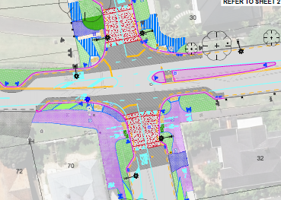
Traffic and Roading
Sarsfield Street speed humps
End treatments on side streets
Re-designed Curran St Intersection

Slide 7
Traffic Jervois Rd
Walking and cycling safety improvements Government policy, supported, and funded.
AT are required by law to consult but there is no formal resource consenting process.

Slide 8
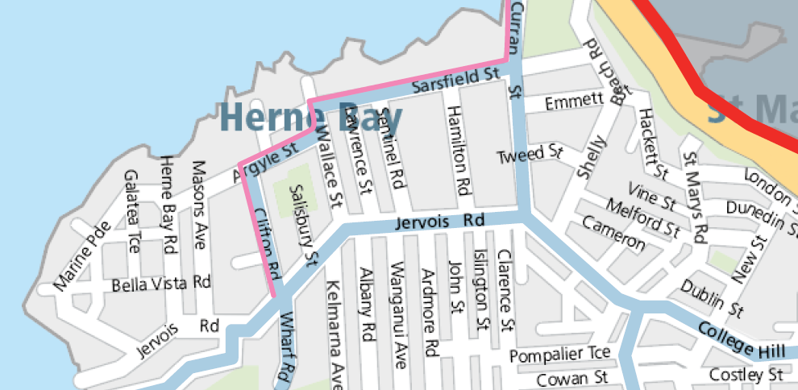
Traffic and Roading
Jervois Road
Feedback from residents
Must haves?
Must not have?
Suggestions?
We want a vibrant shopping
area that services residents.

Slide 9
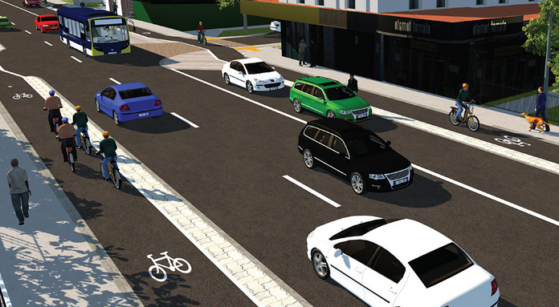
Traffic and Roading
Single Direction Cycleway

Slide 10
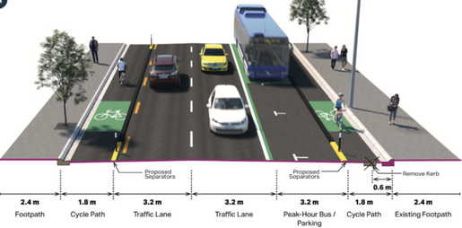
Traffic and Roading

Slide 11
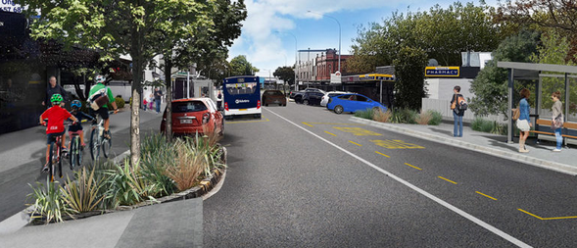
Traffic and Roading
Feedback email: info@hernebay1011.nz

Slide 12
Traffic and Roading
Your suggestions on basis that it happens.
Do residents want HBRAI to engage with council?
Please send us email info@hernebay1011.nz.
We need to be prepared!
Let us know your thoughts.

Slide 13
Save Sentinel Beach
KIA WON! Helicopter Boatshed Consent Quashed
Owner has since applied for a COC on the existing rebuilt boatshed
COC provisionally granted and ONLY for use as a boatshed
Helicopter access is a separate and involved issue
HBRAI seeking written assurance from AC for full public notification
Do members support opposing application at Sentinel Beach?
Do members support opposing other new helipads in Herne Bay?

Slide 14
Herne Bay Helicopters
Three helipads in Herne Bay Cremorne x 2 and 1 Sentinel
18 flights per Week – max 13 per one day
Not monitored by council complaint took 8 mos to resolve
Council relies on complaints to monitor compliance.
One site breached consent regarding log books, 1 on flights.
HBRAI seeking changes in policy, stricter compliance.
HBRAI would like complaints be made via it.
2 letter ID on tail i.e. BZ Time Date.
Location, photo if possible.

Slide 15
Sewage and Storm Water Issues
St Marys Project
Last AGM members suggested HBRAI appeal.
That project was to channel all St Marys Bay and Masefield Beach sewage overflows to a holding tunnel and then be pumped back to the trunk sewer when capacity allowed. If the tunnel filled any surplus (overflow) would be discharged via an outfall near the Harbour Bridge.

Slide 16
Sewage and Storm Water Issues
HBRAI and SMBA appealed because continued old practices using the combined sewer system.
SMBA engaged Australian expert, found many shortcomings
Many changes made to project. Council refunded costs of our expert!

Slide 17
Sewage and Storm Water Issues
New outfall will have no material effect on Herne Bay beaches.
Many safeguards were able to be added via our appeal.
Agreement with Council on revised project.
Includes separation commitment for Herne Bay by 2025
HBRAI share of costs funded by a few local benefactors.
Thanks to all who helped.

Slide 18
Storm Water Discharges
Auckland Wide Storm Water Discharge Consent to combine all existing and future discharges to one 35 year consent.
Council successfully applied for a 35 year storm water discharge consent.

Slide 19
Sewage and Storm Water Issues
Prescribed consultation with the Property Council and Metals NZ but not the public.
HBRAI and SMBA appealed.
Changes now require public consultation, measurement of storm water pollutants and mitigation/elimination contaminant effects.

Slide 20
This and Next Year
Plan 26 Changes for dimensional changes to the Unitary Plan after 600 consents were deemed invalid.
HBRAI and SMBA have made submissions and there is a commissioner hearing next year.
Skypath effects on local parking and traffic.
Save Sentinel Beach issues will continue.

Slide 21
Please Donate Donate Donate
We have no financial resources apart from donations, our time is unpaid, we need funds to effectively address these issues, court filing charges and expert evidence is needed.
If you donate funds to a cause they will only be used for that cause, please note on your donation where it is to go. If you know people who are in a position to give, perhaps anonymously please suggest they do so.

Slide 22
AGM
Now we have the formal part of the AGM
Please stay so we have a quorum
Otherwise, thanks for coming tonight, we really appreciate your interest in the suburb we all share and enjoy.
Good night, and thanks.

